Slide 1
Bloom’s Taxonomy

Slide 2
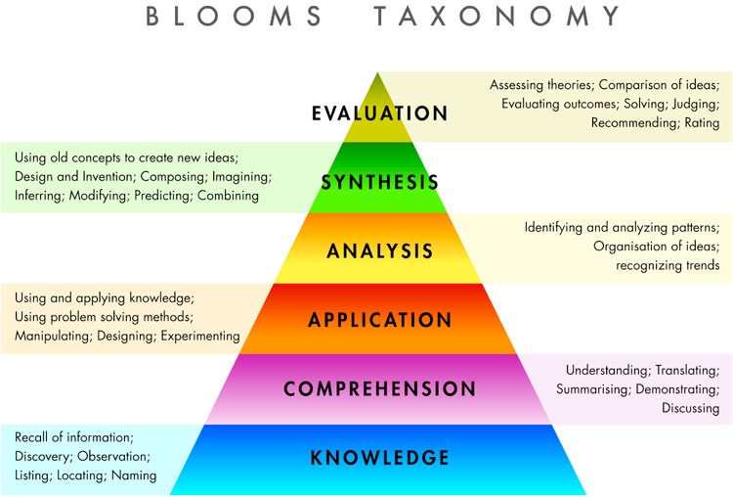

Slide 3
Pirates of the Caribbean
Explain Bloom’s Taxonomy
www.youtube .com/watch?v=cT4Q2n8S4bk

Slide 4
https://www.youtube.com/watch?v=cT4Q2n8S4bk

Slide 5
